Slide 1
Comparative performance analysis of K-nearest neighbour (KNN) algorithm and its different variants for disease prediction
Group 10 : Varun Bhuva, Vedant Patel, Jay Bhingradiya, SriKeerthi Yenumula, Sunavya Varagani
4/11/2023
CSULB Spring 2023
CECS 550: Pattern Recognition
Midterm Presentation

Slide 2
Contents
Abstract
Introduction
KNN Algorithm and its variants
Datasets used
Performance comparison measures
Results
Discussion
Conclusion

Slide 3
Abstract
The use of machine learning algorithms for disease risk prediction.
Comparing the different KNN variants for disease prediction.
Eight machine learning benchmark datasets related to different disease contexts are used
Hassanat KNN and Ensemble app?/roach KNN – Highest Accuracy
It will help healthcare researchers and stakeholders select the appropriate KNN variant for disease prediction
Notes:
The paper discusses the use of machine learning algorithms for disease risk prediction.
The k-nearest neighbour (KNN) algorithm is the most commonly used among the machine learning algorithms.
The paper compares different KNN variants (Classic, Adaptive, Locally adaptive, k-means clustering, Fuzzy, Mutual, Ensemble, Hassanat, and Generalised mean distance) for disease prediction.
Eight machine learning benchmark datasets related to different disease contexts are used for experimentation and analysis.
The performance measures of accuracy, precision, and recall are used for comparative analysis.
The Hassanat KNN and Ensemble approach KNN showed the highest average accuracy values (83.62% and 82.34% respectively).
A relative performance index is proposed to assess each variant and compare the results.
The paper concludes that the Hassanat KNN is the best performing variant based on the accuracy-based version of the index, followed by the ensemble approach KNN.
The findings of this study could help healthcare researchers and stakeholders select the appropriate KNN variant for predictive disease risk analytics.
The paper discusses the use of machine learning algorithms for disease risk prediction.
The k-nearest neighbour (KNN) algorithm is the most commonly used among the machine learning algorithms.
The paper compares different KNN variants (Classic, Adaptive, Locally adaptive, k-means clustering, Fuzzy, Mutual, Ensemble, Hassanat, and Generalised mean distance) for disease prediction.
Eight machine learning benchmark datasets related to different disease contexts are used for experimentation and analysis.
The performance measures of accuracy, precision, and recall are used for comparative analysis.
The Hassanat KNN and Ensemble approach KNN showed the highest average accuracy values (83.62% and 82.34% respectively).
A relative performance index is proposed to assess each variant and compare the results.
The paper concludes that the Hassanat KNN is the best performing variant based on the accuracy-based version of the index, followed by the ensemble approach KNN.
The findings of this study could help healthcare researchers and stakeholders select the appropriate KNN variant for predictive disease risk analytics.

Slide 4
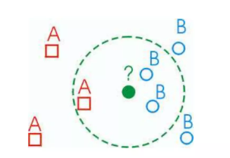
Introduction
KNN - A powerful classification algorithm
K nearest neighbors stores all available cases and classifies new cases based on similarity measure (e.g. distant function)
An object (new instance)
Classification – Majority votes for its neighbor class
Assigned – Most common class among K nearest neighbors

Slide 5
KNN Algorithm and its Variants
Classic KNN
Adaptive KNN
Locally adaptive KNN – with discriminant class
Fuzzy KNN
K-means clustering-based KNN
Weight adjusted KNN
Hassanat distance KNN
Generalised mean distance KNN
Mutual KNN
Ensemble approach KNN

Slide 6
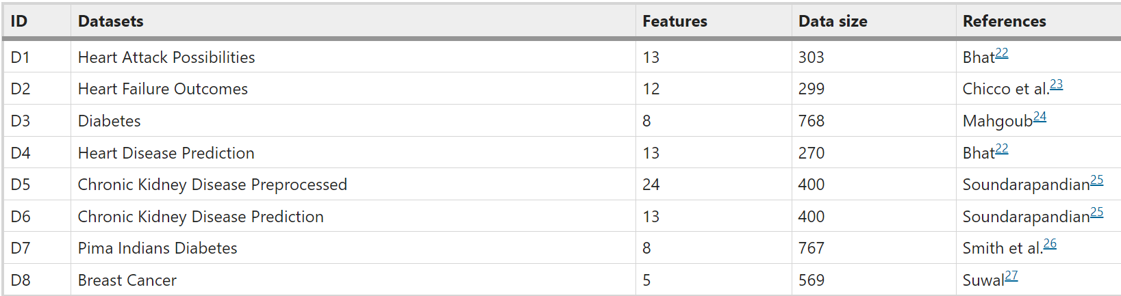
Datasets
Following datasets are considered in the study :

Slide 7
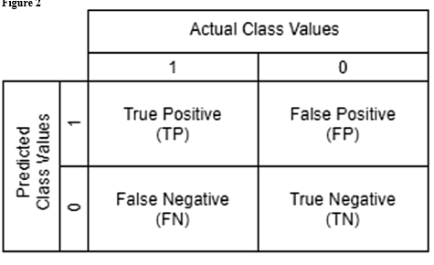
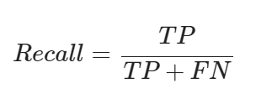
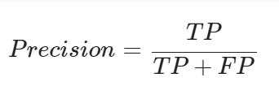
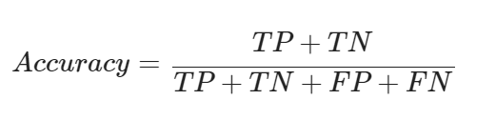
Performance Comparison Measures
Confusion Matrix :
It is used in the research to measure the three performance measure : Accuracy, precision and recall.

Slide 8
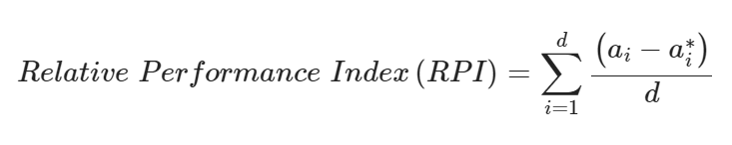



Relative Performance Index :
is the minimum accuracy/precision/recall value among all variants for datasets i
Where,
is the accuracy/precision/recall value for the variant under consideration for dataset i
is the number of datasets considered in this study.

Slide 9
Results
Accuracy (%) comparison among KNN variants.
Precision (%) comparison among different KNN variants.
Recall (%) comparison among different KNN variants.
Comparison of KNN variants showing the number of times they presented the highest measurement values.
Average relative performance index (RPI) scores for the three performance measures.

Slide 10
Discussion
Study compared different KNN variants – (k=1,3,5,7 and 9)
Performance - Worst in K-means clustering-based KNN variant
Accuracy – High in Hassanat KNN variant
Precision classification – High in ensemble approach KNN
Recall- Greater in generalised mean distance KNN variant
Performance measure – No significant difference among all the variants

Slide 11
Conclusion
Most suitable KNN variants (for disease prediciton)
Hassanat, ensemble approach and generalised mean distance
Ensemble approach KNN – prime variant to choose
KNN algorithms limitations can be overcome :
searching for optimal k values,
better weight attributions,
local mean vectors of neighbours,
truncating datasets to remove noise,
taking into account mutual neighbours
KNN designs are versatile
can handle a wide variety of datasets in medical domain

Slide 12
Future scope
studying more variants
comparing them with other related algorithms
and handling a greater number of medical datasets.

Slide 13
References
https://www.nature.com/articles/s41598-022-10358-x

